Slide 1

FastAPI Python framework

Slide 2
HELLO!
I am Essi Junior
I am here to breifly present FastAPI.
You can find me at github@EssiJunior

Slide 3
Roadmap
What is a Web Application ?
What is an API?
FastAPI !
1
3
5
2
4
6
Structure of a Web Application ?
What is a web API ?
Have a demo.

Slide 4
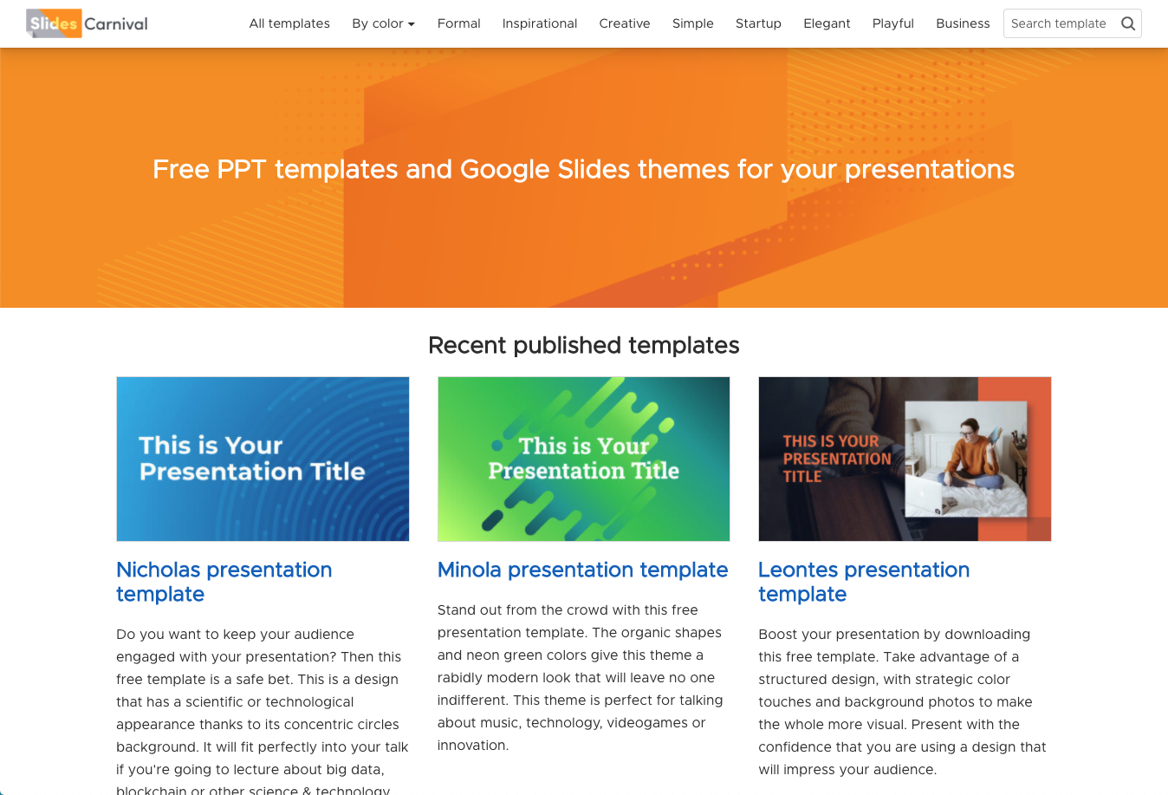
Web Application
It is an application that runs with the use of a web browser and is access via the HTTP protocol.
Example: Udemy, Medium…

Slide 5
Have a view on this!
FRONT-END
BACK-END
The combination of a nice FRONT-END and a well organised BACK-END results to an effective WEB APPLICATION.
Graphic User Interface (GUI), all the buttons, options, tools… that when used produces the service requested. These tools are usually organised in a beautifull manner.
Execution of the tasks requested by the users when he/she selects an option or a tool on the GUI. It is the brain of a web application.

Slide 6
API Application Programming Interface
It is a set of functions, procedures, definitions and protocols for intergrating application software.
An API provides services without us knowing how it is been provided.
Examples of python built-in APIs: round(), bin(), hex(), sqrt()…

Slide 7
Web API
It is an API that is accessible over the web(HTTP) protocol. They allow data to be sent between applications without any knowledge of how the other application works or is built.
Example: YouTube API, Google Map API, Twitter API...

Slide 8
FastAPI
It is a fast (high-performance), easy to learn, fast to code, web framework used to construct APIs with python language.
DB management
CRUD operations
Authentication support
Schemas Validation
CI/CD
Automatic documentation
Test support
Deployment support

Slide 9
I have talk for so long,
Have a view on a demo

Slide 10


Thanks for your attention!

Slide 11
Questions?
Find this demo:
https://github.com/EssiJunior/fastapi-intensive-formation
https://fastapi-ej21.herokuapp.com

